Slide 1
Disaster Management in India
Ms. Khushbu Prasad
Assistant Professor, Amity University Patna

Slide 2
Introduction to Disaster Management
What is Disaster?
“A serious disruption of the functioning of a community or a society involving widespread human, material, economic or environmental losses and impacts, which exceeds the ability of the affected community or society to cope using its own resources.”
(Defined by United Nations International Strategy for Disaster Risk Reduction –UNISDR)

Slide 3
Introduction to Disaster Management
Types of Disaster:
Natural
Man made
Both
Geophysical- Earthquake
Hydrological- Flood
Meteorological- Cyclone
Climatological- Drought
Biological- Epidemics
Soil erosion
Riots
Terrorist attacks
Wars
Accidents
Negligence

Slide 4
Introduction to Disaster Management
What is Disaster Management?
“The systematic process of using administrative decisions, organizations, operational skills and capacities to implement policies, strategies and coping capacities of the society and the communities to lessen the impact of natural hazards and related environmental and technological disasters .”
(Defined by United Nations International Strategy for Disaster Risk Reduction –UNISDR)
Preventive measures taken to minimize the loss of life and damage of property during a disaster.

Slide 5
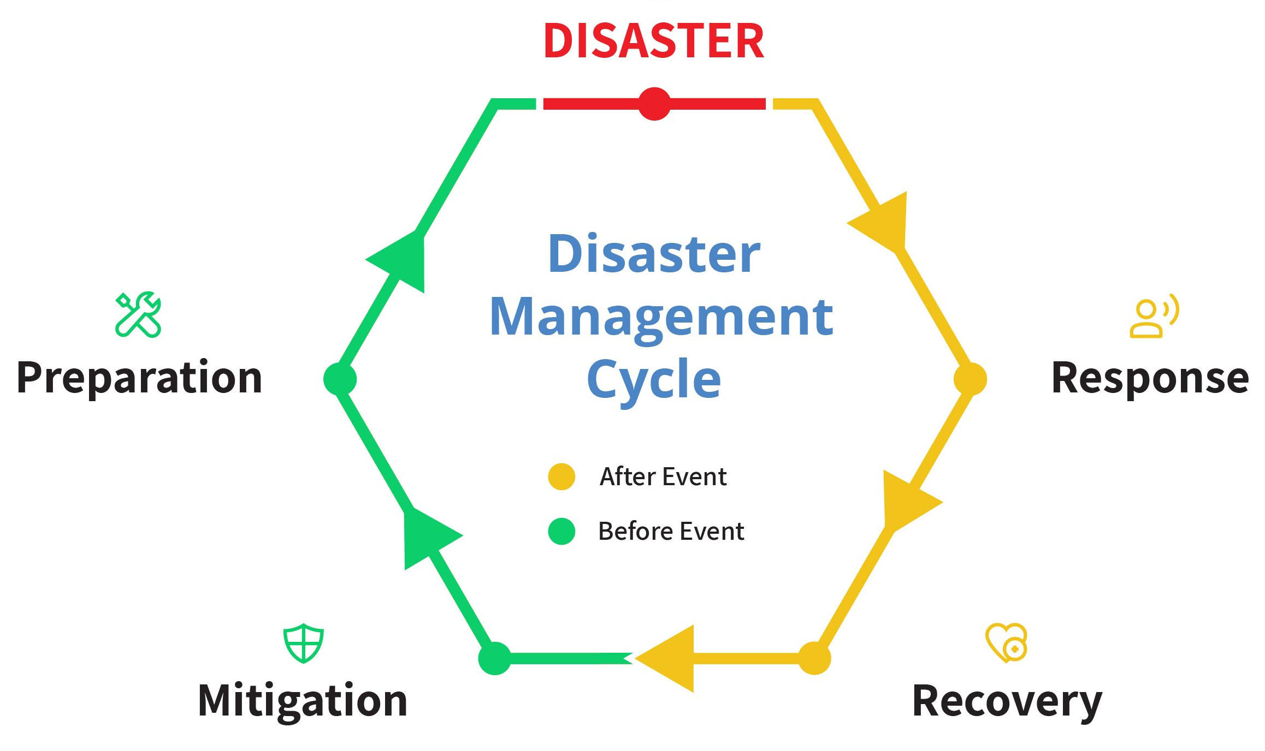
Introduction to Disaster Management
Phases of Disaster Management:
1. Pre-disaster phase
2. Disaster phase
3. Post-disaster phase (Recovery phase)
Disaster Management Cycle:

Slide 6
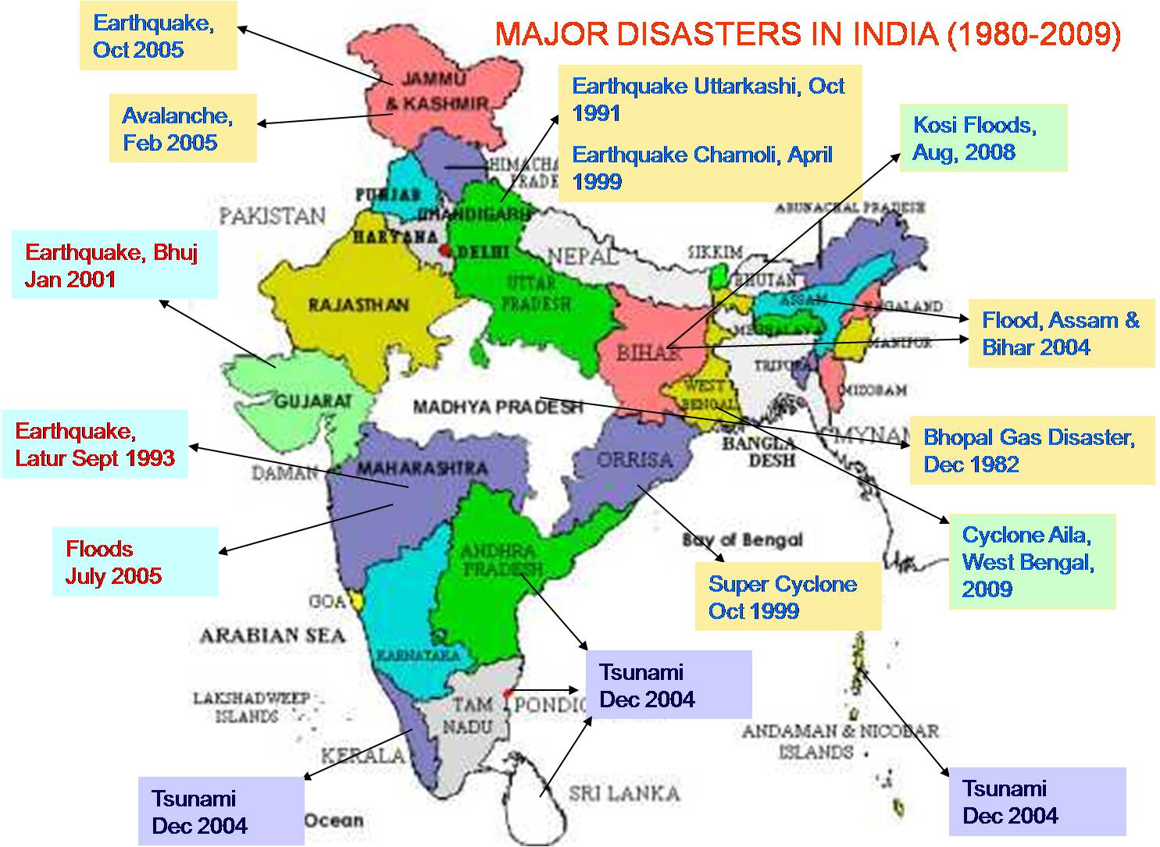

Slide 7
Major Disasters in India
Bhopal Gas Disaster, 1982- among World’s worst Industrial disaster
Super Cyclone Orissa, 1999
Tsunami, 2004
Floods Maharashtra, 2005
Kosi floods, Bihar, 2008
Uttarakhand floods, 2013
Covid-19 pandemic, 2019-2020

Slide 8
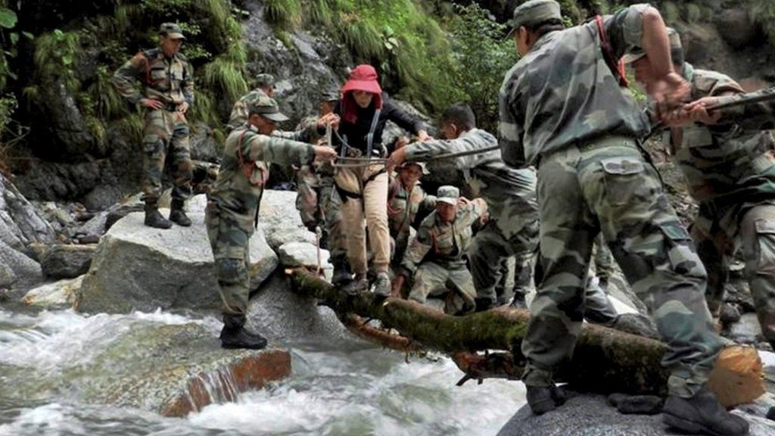
Uttarakhand Floods, 2013
Country’s worst natural disaster since 2004 Tsunami.
Over 95% casualties occurred in Uttarakhand.
According to the figures provided by Uttarakhand Government, >5,700 people were “presumed dead”.
This total included 934 local residents.
Indian Army- Operation Surya Hope
Indian Air Force- Operation Rahat
NDRF
Border Road Organization
Indo Tibetian Border Police (ITBP)

Slide 9
Disaster Management in India
World:
In 1989: UN General Assembly declared the decade 1990-2000 as “International Decade for natural Disaster Reduction”.
India:
In October 1999, Orissa: Super Cyclone
In January 2001, Gujarat: Bhuj Earthquake
Need to adopt multi-disciplinary and multi-sectoral approach
Incorporation of Risk Reduction in development plan and strategies

Slide 10
Disaster Management in India
Ministry of Agriculture Ministry of Home Affairs
Disaster Management is transferred in 2002 to
Relief
Reconstruction
Rehabilitation
Prevention
Planning
Preparedness
Paradigm Shift from relief centric approach to Disaster Risk Reduction (DRR)

Slide 11
Institutional and Policy framework
Based on Disaster Management Act 2005:
NDMA
(National)
SDMA
(State)
DDMA
(District)

Slide 12
Institutional and Policy framework
Overall co-ordination
Ministry of Home Affairs
National Emergency Response Centre (NERC)
Integrated Control Room for Emergency Response (ICR-ER)
National Level:
Top level decision making
Nodal Ministries
National Disaster Management Authority (NDMA)
Cabinet Committee on Security (CCS)
National Crisis Management Committee (NCMC)
National Institute of
Disaster Management (NIDM)
National Disaster Response Force (NDRF)
National Executive Committee (NEC)
State Government /UTs
Armed Forces and Central Armed Police Forces (CAPF)

Slide 13
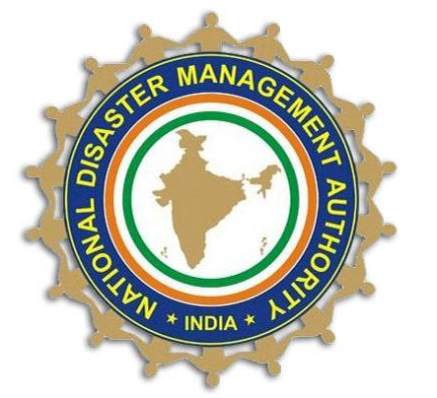
National Disaster Management Authority (NDMA)
is an agency of the Ministry of Home Affairs
Chairperson: Prime Minister of India
whose primary purpose is to -
Co-ordinate response to natural or man-made disasters. (other- NCMC)
Approval of National Disaster Management Plan (NDMP) and facilitating its implementation
Capacity building in disaster resiliency and crisis response
Lay down policies, plans and guidelines for disaster management

Slide 14
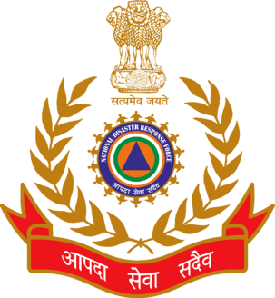
National Disaster Response Force (NDRF)
Specially trained force headed by a Director General Structured like paramilitary forces for rapid deployment.
Each battalion consists of a team of specialists- Engineers, technicians, electricians, etc.
Few are capable of responding to radiological, nuclear, biological and chemical disasters.
Assist the relevant State Government/District Administration in the event of an imminent hazard event or in its aftermath.

Slide 15

National Institute of Disaster Management (NIDM)
Union Home Minister
Nodal responsibilities in the field of disaster management :
Human resource development
Capacity building
Training
Research
Documentation and
Policy advocacy.

Slide 16
Integrated Control Room for Emergency Response (ICR-ER)
The National Emergency Response Centre (NERC) will act as the communication and coordination hub for maintaining constant touch with early warning agencies for updated inputs.
Eventually upgraded as ICR-ER
It will be connected to other control rooms like:
All agencies designated to provide hazard-specific early warnings
State Emergency Operations Centre (SEOC)
District Emergency Operations Centre (DEOC), etc.

Slide 17
Institutional and Policy framework
Central Government Departments
NDMA
State Level:
State Government
State Disaster Response Force (SDRF)
State Executive Committee (SEC)
State Disaster Management Authority (SDMA)
Relief Commissioner/ Nodal Department
District Disaster Management Authority (DDMA)
State Emergency Operation Centre (SEOC)
Departments/ Agencies with DM responsibilities

Slide 18
State Disaster Management Authority (SDMA)
All state Governments are mandated under section 14 of the act to establish a state disaster management authority (SDMA).
Chairperson: Chief Minister of the state, and no more than 8 persons appointed by the chairperson.
Responsibilities:
Drawing up state disaster management plan
Implementing the National plan
State Executive Committee (SEC) will assist SDMA to perform its functions.

Slide 19
District Disaster Management Authority (DDMA)
District Level:
Established by State Government.
Chairperson: Collector or District Magistrate or Deputy Commissioner of the district.
Co-chairperson: The elected representative of the local authority
The DDMA will act as the planning, coordinating and implementing body for DM at the District level.
Will ensure that the guidelines for prevention, mitigation, preparedness, and response measures laid down by the NDMA and the SDMA are followed by all the district-level offices of the various departments of the State Government.

Slide 20
Risks and Challenges
Climate change
Environment and wildlife conservation
Biodiversity conservation
Disaster Management for Cultural heritage sites

Slide 21
Coherence and Mutual Reinforcement of Three Post-2015 Global Frameworks for DRR:
Sendai Framework for Disaster Risk Reduction (Sendai, Japan, March 2015)
Sustainable Development Goals (UN General Assembly, New York, September 2015) and
Climate Change Agreement (Conference of Paris, COP21, Paris, December 2015)
Incorporated in NDMP

Slide 22

Sustainable Development Goals (SDGs) and Disaster resilience
Sustainable Development and Disaster Risk Reduction (DRR) are interlinked.
A single major Disaster (Shock incident- earthquake) can undo hard-won development progress and set back development by years.
Or
A slow onset disaster (Stress incident- drought) can cause socio-economic loss.
Progress in implementing the Sendai Framework contributes to the progress of attaining SDGs. In turn, the progress on the SDGs helps to substantially build resilience to disasters.

Slide 23
Mitigation: Enhancing Disaster Resilience
Improving the Awareness and Understanding of Risk
Enabling Coherence and Mutual Reinforcement of Initiatives under the Major Global Frameworks for Enhancing Disaster Resilience
Capacity Development
Social Inclusion in DRR
Intra-Government Coordination and Integration
Project Appraisal and implementation
Budget Allocations:
National Disaster Response Fund
State Disaster Response Fund
National Disaster Mitigation Fund

Slide 24
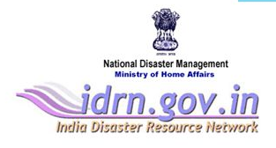
Preparedness and Response
Preparedness
Response
Aims to build the capacities needed to efficiently manage all types of emergencies and achieve orderly transitions from response to sustained recovery.
Role of Local level preparedness: Incident Response Team (IRT)
Role of National Early Warning System
Role of National Emergency Response Centre (NERC)
India Disaster Resource Network (IDRN)
Actions taken directly before, during or immediately after a disaster in order to save lives, reduce health impacts, ensure public safety and meet the basic subsistence needs of the people affected.
Response System Activation: Role of Integrated Control Room for Emergency Response (ICR-ER)
Responding to Requests for Central Assistance from states
Management of Disasters Impacting more than one state

Slide 25
Recovery and Building Back Better
Recovery:
The recovery task of rehabilitation and reconstruction begins soon after the emergency phase ends, and should be based on pre-existing strategies and policies.
The focus of recovery is on restoring livelihoods, shifting to a path of sustainable development that reduces disaster risk.
Recovery programmes, coupled with the heightened public awareness and engagement after a disaster, afford a valuable opportunity to develop and implement disaster risk reduction measures and to apply the “Build Back Better” principle.- Approach matters!

Slide 26
Recovery and Building Back Better
Recovery:
Aspects of Recovery: Physical, Economic, Social
Post-Disaster Needs Assessment (PDNA)
Damage and Loss Assessment (DALA)
Human Recovery Needs Assessment (HRNA)
Recovery Framework

Slide 27
The Path Ahead
With the kind of economic losses and developmental setbacks that the country has been suffering year after year, it makes good economic sense to spend a little extra today in a planned way on steps and components that can help in prevention and mitigation of disasters.
Vision:
“Make India disaster resilient across all sectors, achieve substantial and inclusive disaster risk reduction by building local capacities starting with the poor and decreasing significantly the loss of lives, livelihoods, and assets in different forms including economic, physical, social, cultural, and environmental while enhancing the ability to cope with disasters at all levels.”

Slide 28
“By failing to prepare, you are preparing to fail.”
- Benjamin Franklin

Slide 29
References:
https://www.undp.org/content/undp/en/home/sustainable -development-goals.html
Park Textbook of Preventive and Social medicine- 26th Edition
Textbook of Preventive and Social medicine- Sundarlal
India Disaster Report 2011
Disaster Management in India 2011
National Disaster Management Plan 2019
https://idrn.nidm.gov.in/
https://ndma.gov.in/
http://www.ndrf.gov.in/

Slide 30


